Slide 1


Slide 2
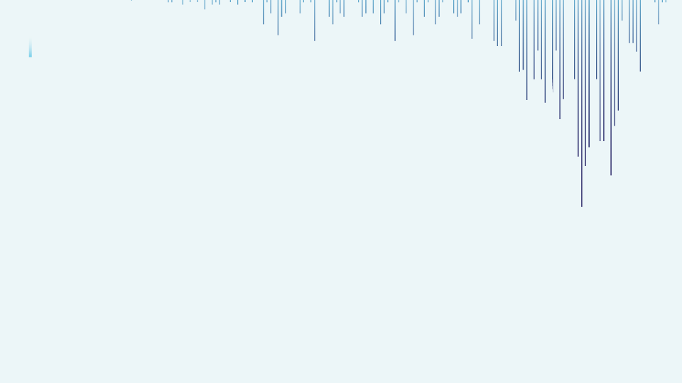


Bank Personal Loan Prediction
Capitalizing on the power of machine learning, our project focuses on refining the prediction algorithms for personal loans, ultimately contributing to improved customer retention strategies within the banking sector."
Presented By :Tanmay Badgujar

Slide 3

INTRODUCTION
This dataset serves as a complete exploration of customer demographics and financial Factors within a banking context.
Bank loans play a crucial role in economic development, and our analysis focuses on applying machine learning to predict loan acceptance and identify potential defaulters.
The datasets include essential features such as age, income, education, and more.
The target variable , 'Personal Loan,' indicates customer acceptance of a loan offer. And it is highly imbalanced.
Our goal is to develop a predictive model that enhances the bank's ability to make informed decisions, reducing the risk of loan and improved the distribution of financial resources.

Slide 4
OVERVIEW
Columns
ID
AGE
EXPERIENCE
INCOME
ZIP CODE
FAMILY
CCAVG
EDUCATION
MORTGAGE
PERSONAL LOAN
SECURITIES ACCOUNT
CD ACCOUNT
ONLINE CREDITCARD
Key Details About The Datasets:
Number of records: Our data have a robust collection of data. Consisting of 5000 rows. Each record is very important
Features/Columns :The dataset is characterized by a various set of features, each providing valuable insights into customer behavior. There are total 14 Columns
Source Of Data: The dataset is sourced from Kaggle, ensuring reliability and relevance.

Slide 5
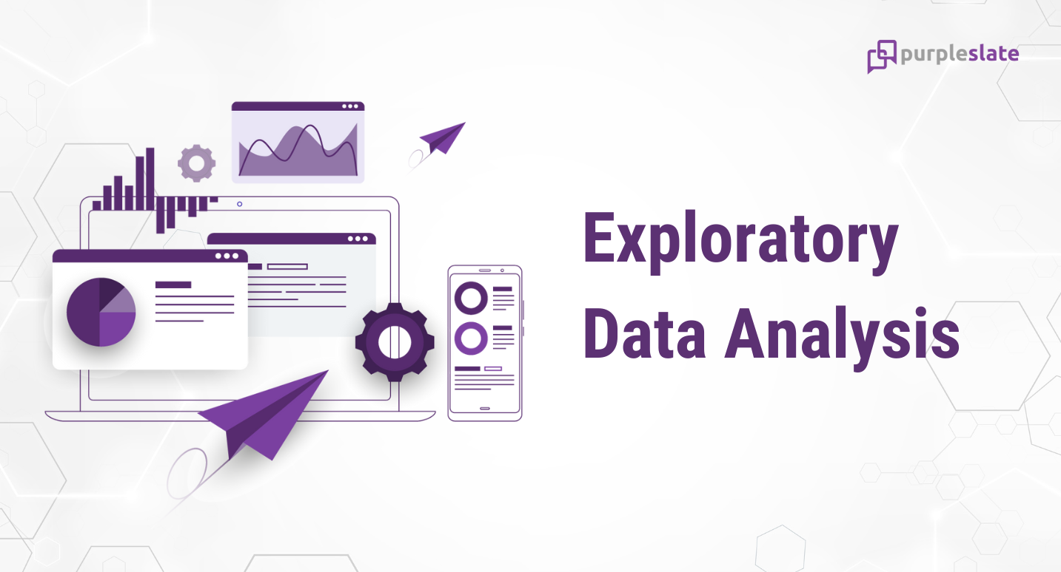
EXPLORATORY DATA ANALYSIS
Exploratory Data Analysis (EDA) helped us understand the data structure, find patterns, identify trends, and gain valuable insights from the dataset.
From EDA we analyze, the distribution of each features, checking the correlation between the features .
Using visuals helped us see the data clearly, understand customer behavior, and pinpoint factors that might cause customers to leave.
The datasets is clean ,there is no NULL & DUPLICATE VALUES
We looked at our data columns and realized that some, like "ID" and "ZIP CODE" didn't help much in making predictions. So, we decided to remove them before further processing.
We used Standard Scaler in preprocessing to keep the scales consistent for numerical features.

Slide 6
DISTRIBUTION OF PERSONAL LOAN
From above pie chart we can see that our target variable distribution is highly imbalanced.
Majority of the customers Not taken the personal loan(90.40%)
Only (9.60%) customers has taken the loan.

Slide 7
EXPLORATORY DATA ANALYSIS
Customers that belong to education category Graduation and Professional have taken more Personal Loan then the Undergraduate class.
Family size of 3 and 4 members are tending to take Personal Loan.

Slide 8
The customers who do not have a securities A/C have taken more loans compared to those who have a securities A/C.
We can see that customers who have a Certificate of Deposit (CDAccount) have mostly taken a Personal Loan.

Slide 9
Customers who use online Bank services are more likely to have a higher number of personal loans than those who do not using online banking services.
Most people who have a credit card do not seem to take out a personal loan.

Slide 10
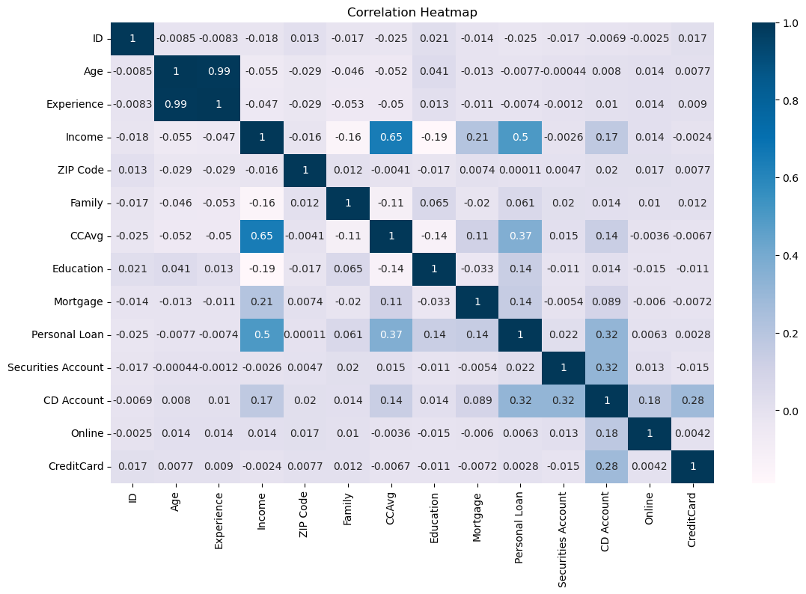
CORRELATION HEATMAP
"Experience" and "Age" looks like highly positively correlated with each other. We can remove one of the variable to avoid multi-collinearity problem.
The other point is "CCAvg" & "Income" is also correlated with each other.
But "CCAvg" contains values in month & "Income" contains values in annually.
we need to replace "CCAvg" in Annual.

Slide 11
PREPROCESSSING
We removed the “Id" and "ZIP CODE" columns because they didn't help us predict anything useful.
Experience Columns have some negative values , and this is highly correlated with Age. So, handling with negatives values I Drop “Experience” Column To Avoid Multi Collinearity.
Replace the Values of correlated features
SPLITING THE DATA INTO X & Y
We divided the dataset into two parts: X and y.
"X" typically represents the independent Variables, and "y" represents the Dependent (target variable) that we want to predict or understand.

Slide 12
TRAIN TEST SPLIT
We divided the data into training (80%) and testing (20%) sets.
Setting a random state of 123 ensures consistent results and using stratify=y maintains a proportional distribution of the target variable in both sets.
STANDARD SCALER
We used Standard Scaler to make sure all numeric features in the dataset have similar scales.
This consistency is important for certain machine learning methods.
It helps the models to perform better.

Slide 13
SMOTE TECHNIQUE
Over-sampling Technique used in machine learning to address the class imbalance problem, particularly in classification tasks where one class significantly outnumbers the other.
This helps balance the class distribution.
I am using over sampling because, we aim to improve the model's ability to recognize and generalize patterns in the minority class, resulting in a more balanced and powerful predictive model.
By using the SMOTE technique, we can generate synthetic samples of
the minority class (Personal Loan Taken) to balance the dataset.
Here both class is equally distributed
Not Taken Personal Loan(0) = 3616
Taken Personal Loan(1) = 3616

Slide 14
MODEL SELECTION
Models used:
Logistic Regression: logistic Regression is commonly used for binary classification problems. it's preferred because it provides a simple an efficient way to model the relationship between the independent variables and the probability of a certain outcome.
Naive Bayes: Naive Bayes algorithms are used for classification because they are simple, computationally efficient, and effective in handling high-dimensional data. They are particularly well-suited for text classification tasks.
Support Vector Machine: SVM is a powerful supervised algorithm that works best on smaller datasets but on complex ones. Support Vector Machine(SVM)can be used for both regression and classification tasks, but generally, they work best in classification problems.

Slide 15
MODEL COMPARISON
MODELS | ACCURACY | PRECISION | RECALL | F1 SCORE
Logistic Regression | 0.884 | 0.447368 | 0.885417 | 0.594406
Naive Bayes | 0.878 | 0.430851 | 0.843750 | 0.570423
Support Vector Machine | 0.955 | 0.691729 | 0.958333 | 0.803493
After evaluating different models for Bank Loan Analysis including Logistic Regression, Naïve Bayes & Support Vector Machine.it can be concluded that the Support Vector Machine algorithm is outperforming other algorithms in every metric.
One of the key advantages of support vector machine is that work best in classification problems.
While metrics like Accuracy and Precision are essential, Recall is particularly crucial in Customer Personal Loan Prediction, as it indicates the ability to identify customers who are likely to take loan. And Support Vector Classification provided us the best Recall value.
Hence, we will go with Support Vector Classification as our final model as it is quite evident that it performs best for our Bank Personal Loan Problem.

Slide 16
CONCLUSION
In conclusion, the analysis reveals that the dataset contains a highly imbalanced target variable, with a majority of customers (4520) not taking personal loans (0) and a smaller number (480) taking loans (1).
Further exploration indicates that customers with educational backgrounds in Graduation and Professional categories are more likely to take personal loans compared to those with an Undergraduate education.
Family size also plays a role, with customers from families with 3 or 4 members showing a higher tendency to take personal loans.
The absence of a securities account seems to be associated with a higher likelihood of taking a personal loan, while having a Certificate of Deposit (CDAccount) is positively correlated with personal loan uptake.
Additionally, customers using online banking services are more inclined to have personal loans.
There is a negative trend where individuals with credit cards are less likely to take out personal loans.

Slide 17
Addressing the imbalanced target variable, the SMOTE (Synthetic Minority Over-sampling Technique) method has been employed along with standard scaling for numeric features (age, CCavg, mortgage, income). Outliers are present but are not considered as error points.
Among the tested algorithms (Logistic Regression, Naive Bayes, and Support Vector Machine), SVM outperforms others across multiple metrics, including accuracy (96.3%), precision (73.99%), recall (94.79%), and F1 score (83.11%).
This suggests that SVM is the most suitable model for predicting personal loan uptake in this dataset

Slide 18


